Slide 1
Gaming on Linux
Is it even possible?!?!?!

Slide 2
Some resources
gamingonlinux.com -- News / Articles + Forum
linux-gaming.kwindu.eu -- A community built wiki
areweanticheatyet.com -- Are we anti-cheat yet?
gamersonlinux.com -- Forum
protondb.com -- Crowdsourced game compatibility report for Proton

Slide 3


01
Launchers & Backends
How to install games and what they run on

Slide 4

Lutris
lutris.net - Python3, GTK
Helps you install your games - Can connect with existing accounts like Steam, GOG
Provides runners as well (.e.g compatibility layers, emulators, game engine re-implementations)
Integrates with other game clients / launchers (e.g. Epic Games Store)

Slide 5

Heroic
heroicgameslauncher.com - Electron, TypeScript, NodeJS
Launches games from Epic Game Store, GOG Games and Amazon Games

Slide 6

Wine
Wine = Wine Is Not an Emulator
Compatibility layer - Runs Windows apps on POSIX systems
Translates Windows API calls into POSIX calls
Notes:
https://gitlab.winehq.org/wine

Slide 7


Anti-cheats
Measures: File integrity checks, behavioural measures,
Some have proton runtimes but can be disabled by the game devs
Userspace vs kernel space
Notes:
https://sam4k.com/whats-the-deal-with-anti-cheat-on-linux/

Slide 8
02
Hardware
Basically GPUS

Slide 9
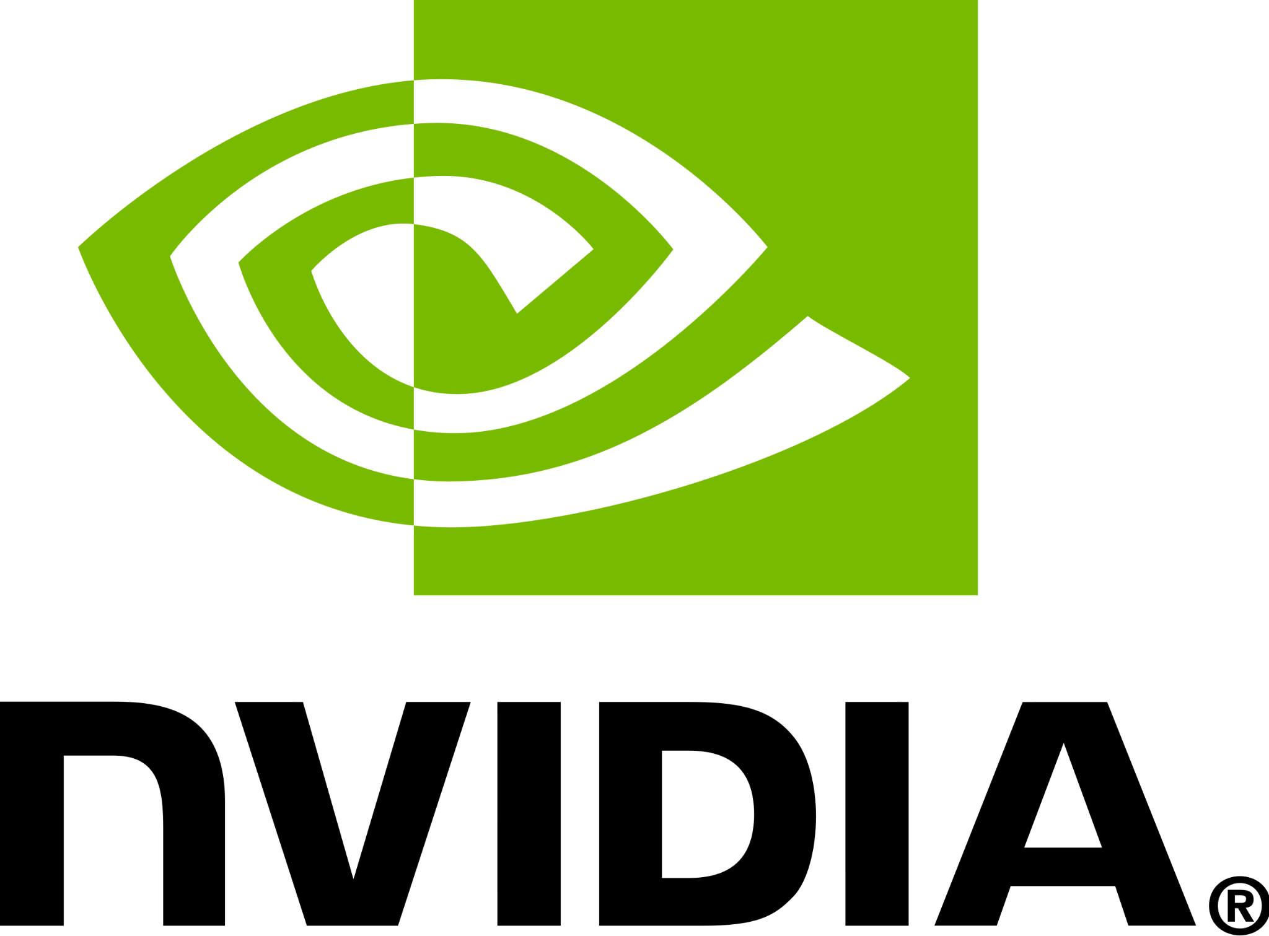
Nvidia
Mandatory video: https://www.youtube.com/watch?v=MShbP3OpASA&t=2894s
Releases closed-sourced blobs
nouveau - Open source project to build drivers for Nvidia cards - nouveau.freedesktop.org/FAQ.html#technicalquestions
TLDR; Nvidia and Linux works fine most of the time. Proprietary drivers are better than nouveau
Notes:
https://linux-gaming.kwindu.eu/index.php?title=Hardware_Recommendations

Slide 10

AMD
Has open-source drivers for Linux - Worked on by AMD as a development tree in kernel source code
kernel.org/doc/html/latest/gpu/amdgpu/index.html
Notes:
https://linux-gaming.kwindu.eu/index.php?title=Hardware_Recommendations

Slide 11
03
Valve & Steam
Not an evil company… yet

Slide 12
Proton
A tool used within the Steam client to run Windows-exclusive titles on Linux. Recommended to use it within Steam client.
Uses Wine under the hood
protondb.com

Slide 13
SteamOS
Used to be Debian 8 (Jessie) (1.0 - 2.0), now Arch Linux (3.0)
Optimized for the “living room experience”, not all hardware is supported
Steam Deck, Steam Machines
Now 3.0, not for desktop use!
Notes:
https://store.steampowered.com/steamos

Slide 14
Remaining word salad
OpenGL
Vulkan
Notes:
https://store.steampowered.com/steamos

Slide 15
THANKS!
Please keep this slide for attribution.

